Slide 1

<SINCE 1999/>
< Bootstrap />
LiDAR and SLAM
See your car's LiDAR in RViz, understand how the pieces talk to each other, and leave with leads to build a map.
{ <TECH TOGETHER TOMORROW> }
Notes:
Goal of the day: LiDAR visible in RViz, understanding of the node/topic/TF plumbing, and leads for SLAM. SLAM itself is open work, not a validated solution.

Slide 2

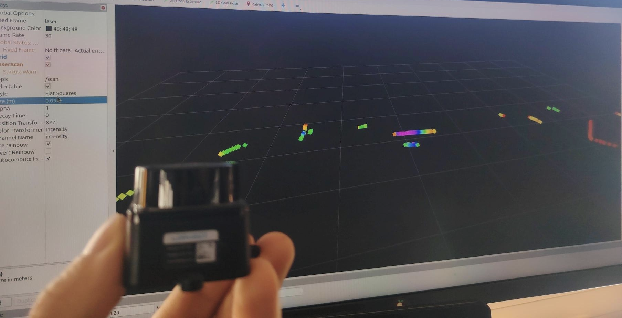
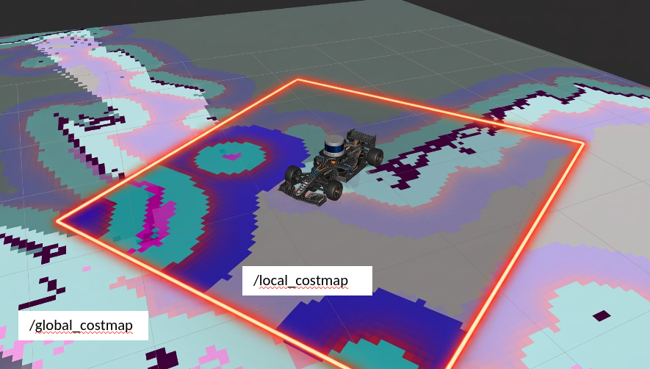

< introduction />
Goal of the day
01
02
03
Understand ROS2 plumbing
See the LiDAR in RViz
Leave with SLAM leads
The scan of your own car, live on your PC.
A starting point to build a map, to explore yourselves.
How nodes, topics and TF frames talk to each other.
Notes:
Three outcomes. The first one is the win condition of the day; SLAM is a bonus track.

Slide 3
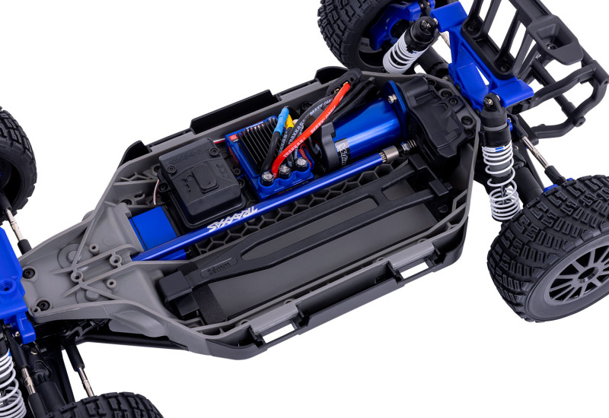
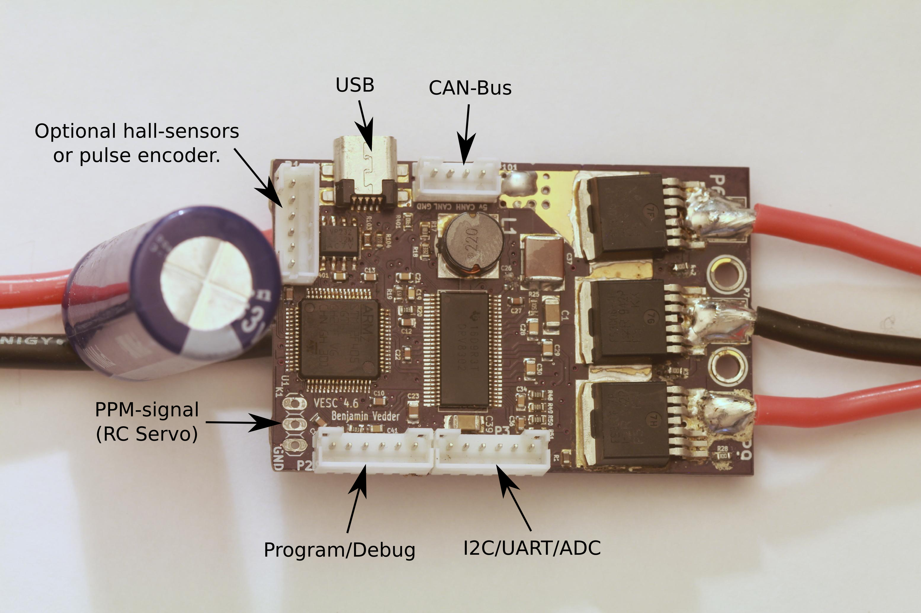
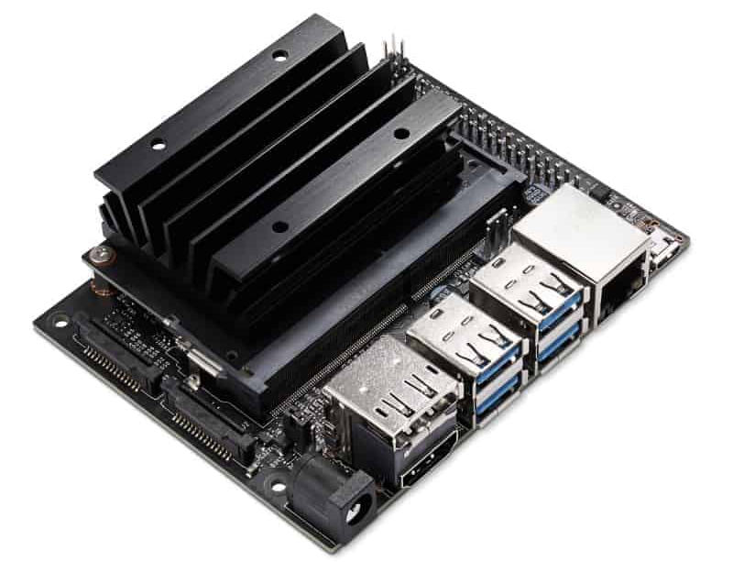
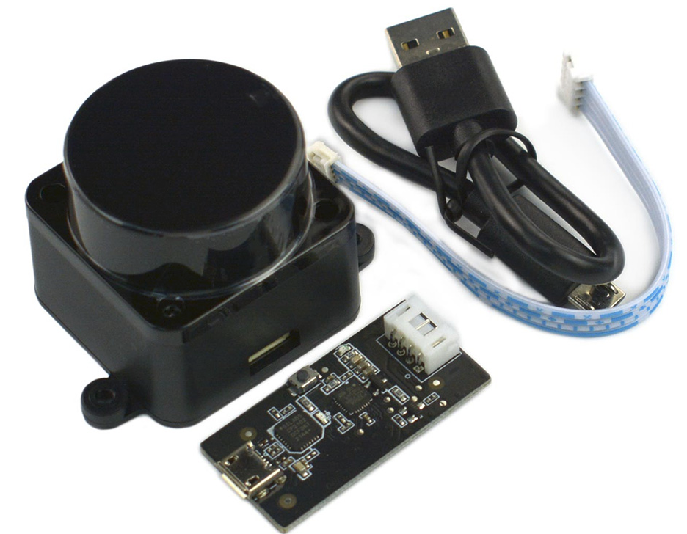
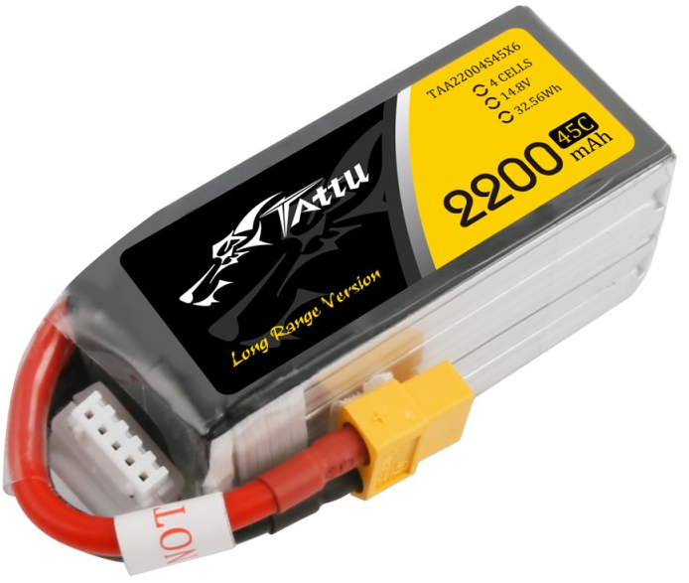
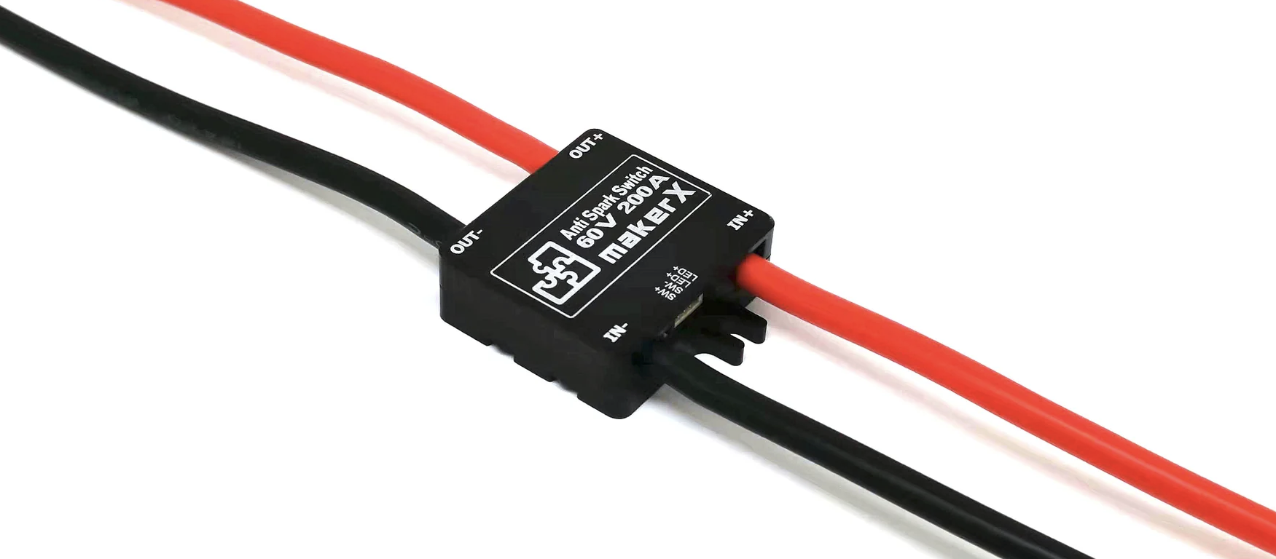
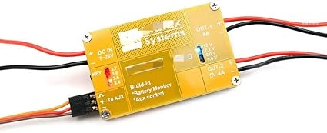
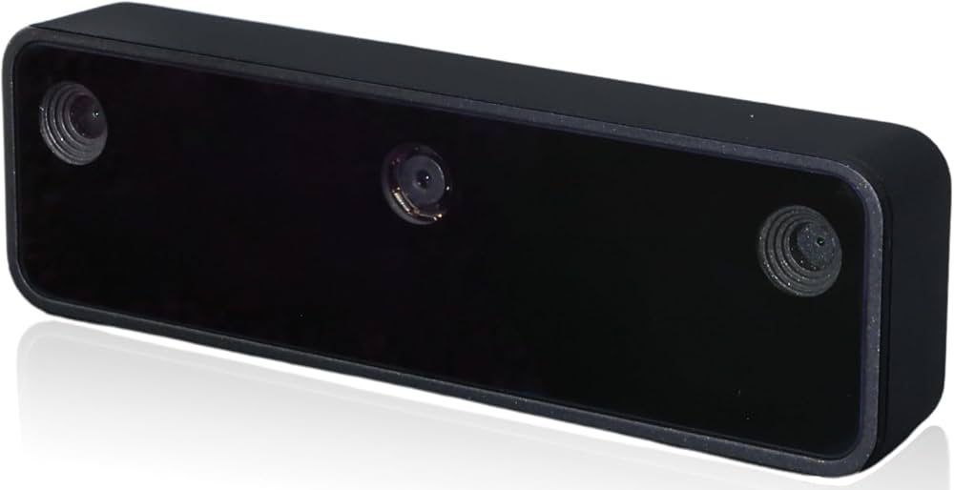
< introduction · hardware />
On the car
chassis
motor controller
computer
Traxxas Fiesta ST Rally
VESC (Hw 60, Fw 7.00)
Jetson Nano 4 GB
BL-2s: 3300 kV motor, 4 poles, sensorless
Drives the motor and the steering servo. Already configured
JetPack 4.6.1, 64 GB microSD, fan. Barrel jack, J48 jumper in place
lidar
battery
power
LDRobot LD19 / STL-19P
LiPo 4S
Anti-spark, DC converter
USB, shows up as /dev/lidar
2200 or 3700 mAh
Full at 16.8 V, stop below 14.0 V
XT60, 12 AWG. Battery → VESC, and → Jetson via 5 V
wi-fi adapter
camera
gps rtk
USB
Luxonis OAK-D Lite
Point One
Connects the Jetson to your PC
Not used today
Not used today
Full parts list: tek5-robocar.github.io/robocar_documentation/bom (purchase links are outdated)
Notes:
Battery: 4S LiPo, full at 16.8 V, never below 14.0 V (3.5 V per cell). Camera and GPS are on the car but out of scope today.

Slide 4
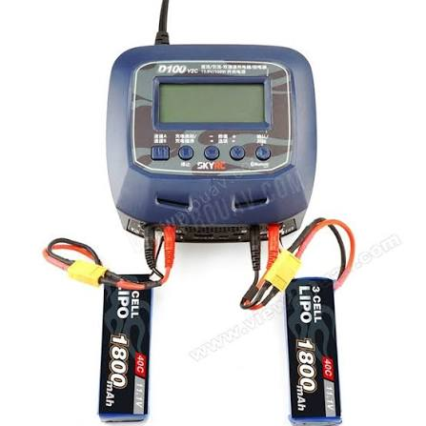

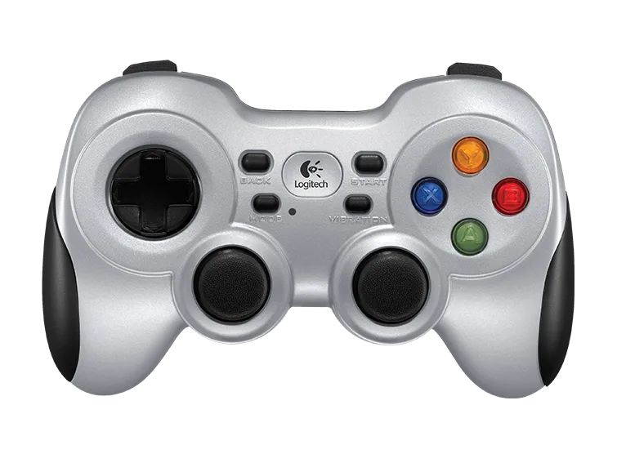
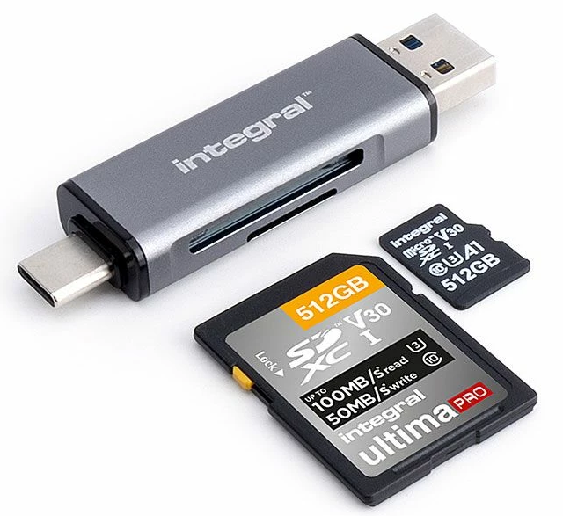
< introduction · hardware />
Side material
Battery voltage checker
One or a few per campus, shared between cars
< mandatory />
Gamepad Logitech F710
Car stand
Switch on the back on X, MODE LED off. Short range only
First tests are always done wheels in the air.
USB SD card reader
To flash or back up the Jetson's card
Notes:
The stand is non-negotiable for first tests. F710: switch on X (XInput) and MODE LED off, otherwise the stick mapping is wrong.

Slide 5
< Part 1 />
Recap
The original documentation (assembly, parts list, 3D models, VESC, GPS) still applies, with some required changes.
tek5-robocar.github.io/robocar_documentation · update coming soon
Notes:
The website is being updated. Until then, this recap lists what differs from it.

Slide 6
< part-1 · recap />
VESC Tool: what changed
Already reconfigured on your car: do not redo the original procedure (?).
Original documentation | Now | Why
Motor type Medium Outrunner | Small Inrunner, 4 poles, no temp. sensor | Original values were for a skateboard motor: too much current at detection can burn it
Keep FOC instead of BLDC | Stay in FOC | As we are changing other params, this needs to be retested. FOC is still recommended: BLDC is simpler, but it jerks at low speed. FOC is smooth and linear, which keeps low-speed odometry stable and reduces vibration seen by the IMU.
No limits | Motor 30 A, battery 20 A, max ±30000 ERPM | The BL-2s is designed for 2S, and here it runs on 4S
Li-ion cutoff voltages | Cutoff 14.0 V / 13.2 V | Protects the LiPo (3.5 V / 3.3 V per cell)
App settings not specified | No App, servo output on, timeout 500 ms | No command for 500 ms → the motor stops. The last safety net
Control with pyvesc | ROS 2, /drive topic | pyvesc and ROS would fight over the same USB port
Notes:
FOC (Field-Oriented Control) vs BLDC (trapezoidal commutation). ERPM = electrical RPM, i.e. mechanical RPM × pole pairs. The 500 ms timeout is the last line of defence if everything else fails.

Slide 7



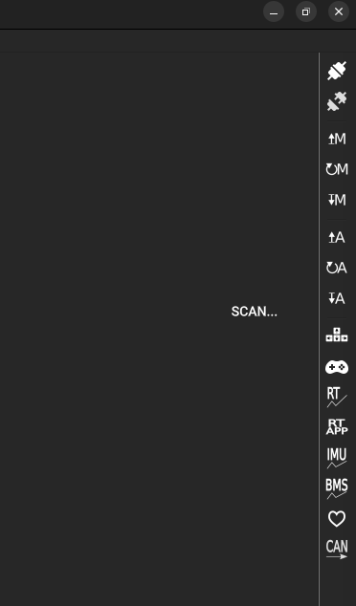
< part-1 · recap />
VESC: three things to remember
Two write buttons
Stored in the VESC
Old service stays off
In VESC Tool, Write Motor Configuration (M) and Write App Configuration (A) are separate.
The configuration lives in the controller. Nothing to reapply at startup.
vesc-config.service rewrote the config at each boot. It is disabled and must stay disabled.
Full procedure and values: host/vesc/README.md
Notes:
Common mistake: writing only the motor config and forgetting the app config (or vice versa).

Slide 8
< part-1 · recap />
Other changes
ROS 2 Jazzy in Docker
The car software runs in containers on the Jetson (Part 2) → ubuntu 24.04
ML in a separate Docker
The ML methods requiring CUDA, Torch… → ubuntu 18.04 (as the jetson)
F1TENTH conventions
Topics, frames and gamepad: their tutorials, simulator and SLAM configs work as-is
Safety chain
Nothing moves unless button RB or LD is held (Part 2)
Stable device names
/dev/vesc and /dev/lidar, whatever the plug order
Time from your PC
The Jetson has no clock battery: it takes its time from your PC (chrony)
Notes:
Stable names come from udev rules. The clock point matters for SLAM later: mismatched clocks make TF reject data.

Slide 9
< Part 2 />
ROS 2
Nodes, topics and Docker services, then driving the car with the gamepad.
Notes:
Goal of this part: everyone drives the car on the stand with the gamepad and understands the safety chain.

Slide 10



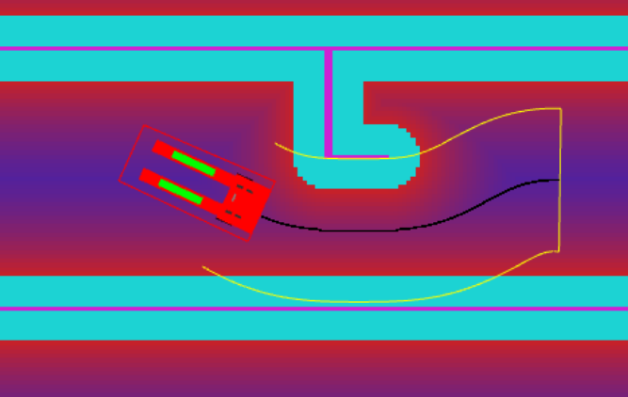
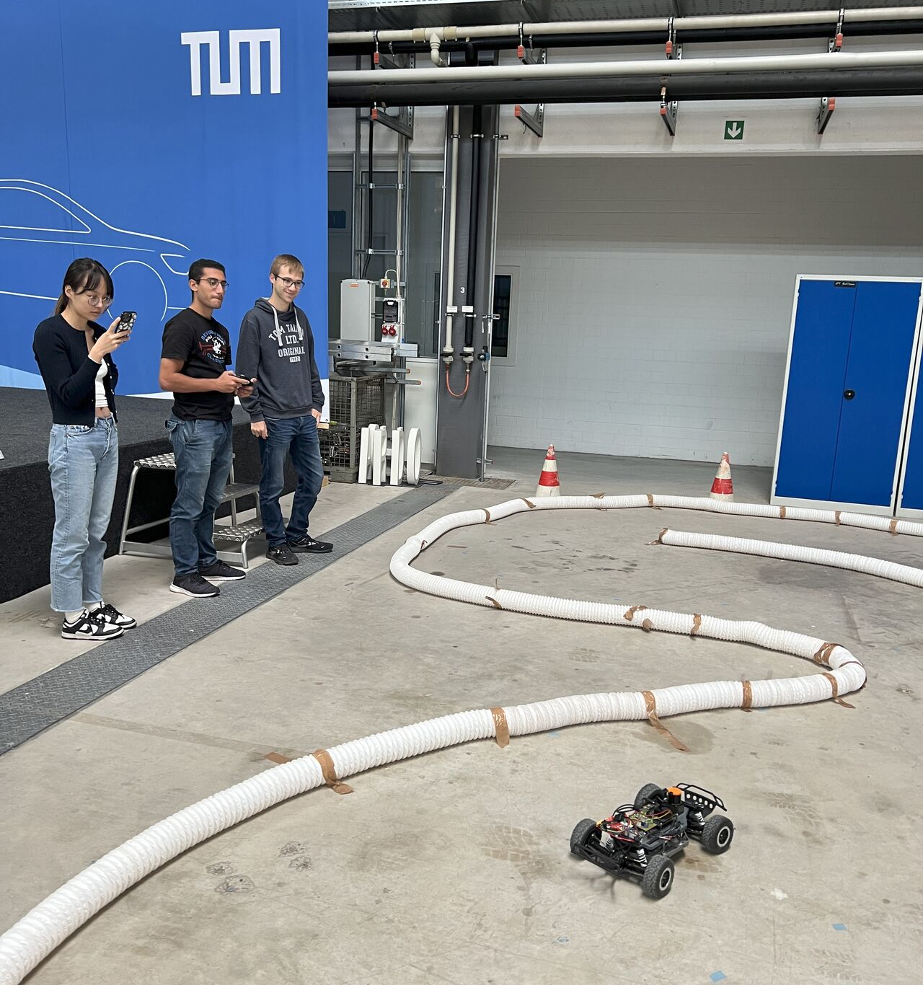
< part-2 · ros2 />
Why ROS 2
Small programs
Ready-made tools
F1TENTH
Each node does one thing: read the LiDAR, drive the motor, read the gamepad.
Replace or add one without touching the others.
RViz to visualize, slam_toolbox for mapping, Nav2 for navigation.
Same code and conventions as F1TENTH, a large community of 1/10 racing cars.
Notes:
F1TENTH compatibility is the main lever: their simulator, tutorials and SLAM configs can be reused without adaptation.

Slide 11
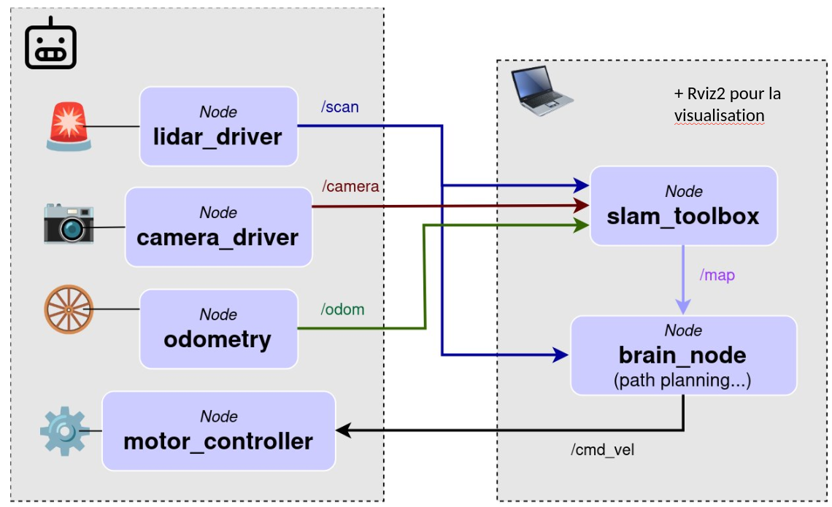
< part-2 · ros2 />
ROS 2 Briefly
Notes:
F1TENTH compatibility is the main lever: their simulator, tutorials and SLAM configs can be reused without adaptation.

Slide 12


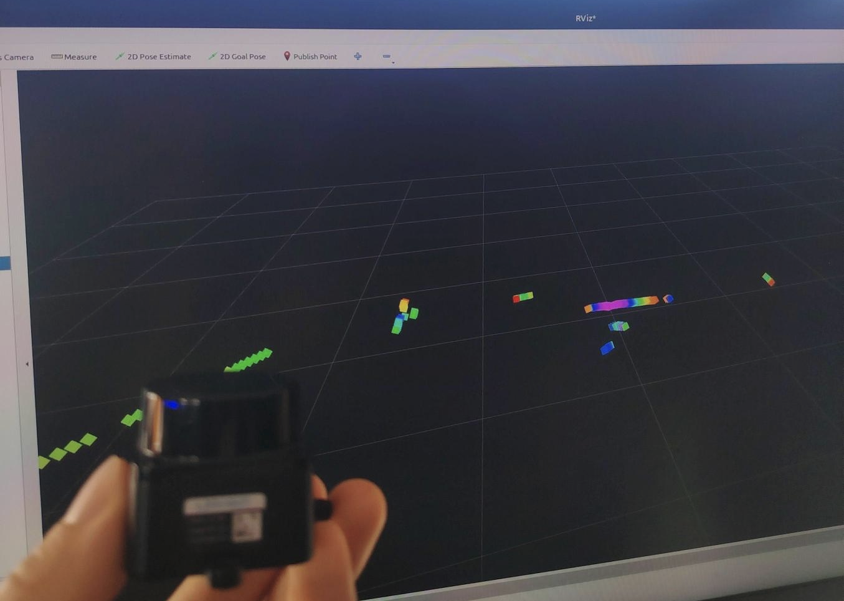
< part-2 · ros2 />
Nodes and topics, with our code
RViz
publishes
ldlidar
/scan
slam_toolbox
node · reads the LiDAR
LaserScan · ~10 Hz
subscribe
your own code
The publisher does not know who listens.
Any node can subscribe to /scan.
Nodes find each other automatically with the same ROS_DOMAIN_ID: that is why your PC sees the Jetson's topics.
Notes:
Message type is sensor_msgs/LaserScan, about 10 Hz. Discovery is DDS multicast on the local network, scoped by ROS_DOMAIN_ID.

Slide 13
< part-2 · ros2 />
Docker services and profiles
On the Jetson, each group of nodes runs in a Docker service, started by its profile.
control
lidar
camera_3d_oak
VESC, gamepad, odometry, TF
ldlidar, today's topic
OAK-D, not used today in this bootstrap
# On the Jetson (ssh robocar@<IP_Jetson>)
cd ~/Robocar_ROS2/docker
docker compose up -d control lidar # start the control and lidar containers
Notes:
Profiles let you start only the groups you need. Add --profile lidar on top of control for today.

Slide 14








< part-2 · ros2 />
What is there, what is not
< jetson />
/drive
< your-pc />
joy + joy_teleop
ackermann_mux + safety
vesc_driver + vesc_to_odom
your node
→ /teleop
→ /odom, TF odom→base_link
→ /drive (not written yet)
robot_state_publisher
RViz
URDF → TF base_link→laser
displays scan, TF, map
oak camera
GPS RTK
ldlidar
slam_toolbox
not done
not done
→ /scan
→ /map, TF map→odom
Works, tested on the car
Today's topic
Not done yet
ARCHITECTURE.md
Notes:
Green: driving, gamepad, safety, odometry, all tested. Blue: today (LiDAR, TF, RViz, then SLAM leads). SLAM can run on the PC or on the Jetson, see Part 4. Grey: camera, GPS and your own driving node. Everything crossing between the two panels goes over Wi-Fi. Full list of nodes, topics and TFs in ARCHITECTURE.md.

Slide 15
< part-2 · driving />
Start the car
Wheels in the air: car on a stand for the first tests.
1
Plug in the LiDAR and the gamepad dongle, then the battery (it powers the VESC and the Jetson). Wait about 1 min for ssh.
2
Start the control profile and follow the logs.
# On the Jetson (ssh robocar@<IP_Jetson>)
cd ~/Robocar_ROS2/docker # folder with compose.yaml, all docker compose commands run from here
docker compose up -d control # start the control service in the background (-d)
docker compose logs -f control # follow its logs, Ctrl+C to leave
A few "Out-of-sync with VESC" errors at startup are normal. They stop after "Connected to VESC".
Notes:
Order matters: USB devices first, then battery, so the udev names are ready when the containers start.

Slide 16

< part-2 · driving />
Get a ROS 2 shell
ROS 2 is not installed on the Jetson itself, only in the containers !
# On the Jetson (ssh robocar@<IP_Jetson>)
cd ~/Robocar_ROS2/docker
docker compose exec control /entrypoint.sh bash # open a shell inside the control container
# Now inside the control container. Type exit to go back to the Jetson
ros2 topic echo /sensors/core --once # voltage_input ≈ battery voltage, fault_code 0
/entrypoint.sh loads ROS 2 and checks ROS_DOMAIN_ID. A plain docker exec -it <container> bash skips it, and ros2 is not found.
Notes:
First sanity check: /sensors/core gives battery voltage and VESC fault code. fault_code must be 0.

Slide 17

< part-2 · driving />
Buttons and the safety chain
Button | Effect
Nothing | The car does not move, even if a node publishes /drive
LB held | Manual: left stick = speed, right stick = steering
RB held | Your node drives: /drive goes through
RB + LB | The gamepad takes over from your node
RB is a dead man's switch
Release it and the car stops in less than 0.2 s. Same if the gamepad is lost or your node crashes.
Notes:
The mux only forwards /drive while RB is held. Autonomous code must never bypass ackermann_mux.

Slide 18
< part-2 · driving />
Check your node is blocked without RB
# Inside the control container
ros2 topic pub -r 20 /drive ackermann_msgs/msg/AckermannDriveStamped "{drive: {speed: 0.5}}"
no button
hold RB
release RB
Nothing moves
The wheels turn
They stop
Ctrl+C to stop publishing.
Notes:
Everyone does this test before writing any autonomous node. Car on the stand.

Slide 19
< Part 3 />
LiDAR integration
You can drive with the gamepad. Next: plug in the LiDAR, find it in the code, see it in RViz.
Notes:
Checkpoint: every group should be driving on the stand before moving on.

Slide 20
< part-3 · lidar />
Plug it in
1
Plug the LiDAR into the Jetson's USB. Its head starts spinning (you can hear it).
2
Check that the Jetson sees it.
ls -l /dev/lidar # → ttyUSB*
3
Start the lidar service (after a replug, add --force-recreate lidar).
# On the Jetson (ssh robocar@<IP_Jetson>)
cd ~/Robocar_ROS2
docker compose up -d control lidar # start the control and lidar containers
Notes:
/dev/lidar is a udev symlink, stable whatever the USB port. After a replug, the container keeps the old device handle, hence --force-recreate.

Slide 21
< part-3 · lidar />
Where it is in the code
Paths under ros2_ws/src/, except the compose file.
File | Role
docker/compose.yaml, service lidar | Starts the container, gives it /dev/lidar
robocar_bringup/launch/lidar.launch.py | Starts the ldlidar node
robocar_bringup/config/lidar.yaml | Settings: port, baud rate, topic scan, frame laser
third_party/ldlidar_stl_ros2/ | The manufacturer's driver (not modified)
robocar_description/urdf/robocar.urdf.xacro | Where the LiDAR sits on the car
Notes:
The URDF file comes back two slides later: its positions are placeholders.

Slide 22
< part-3 · lidar />
Check it works
From your PC (set up as in README.md §2), or inside the control container.
ros2 topic list # /scan must be there
ros2 topic info /scan -v # who publishes (ldlidar), who subscribes
ros2 topic hz /scan # ~10 Hz
ros2 topic echo /scan --once # one message
ranges
angle_min, angle_max, angle_increment
header.frame_id: laser
One distance per angle, in metres. inf or 0.0 means no return.
The frame the measures are expressed in (next slide).
Which angle each value corresponds to.
Notes:
Angle of ranges[i] = angle_min + i × angle_increment. inf and 0.0 must be filtered before any processing.

Slide 23
< part-3 · lidar />
Plug it with the control (for the TFs)
3
# On the Jetson (ssh robocar@<IP_Jetson>)
cd ~/Robocar_ROS2
docker compose up -d control # start the control container (lidar already running)
Notes:
/dev/lidar is a udev symlink, stable whatever the USB port. After a replug, the container keeps the old device handle, hence --force-recreate.

Slide 24
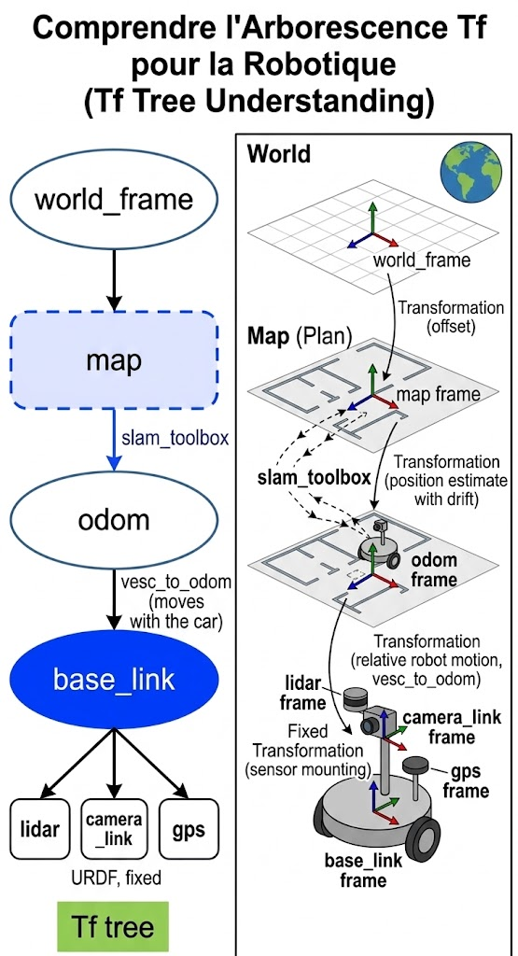
< part-3 · lidar />
Frames and TF
Frame
An origin and three axes. On the car: x forward, y left, z up (REP-103).
base_link
The car itself: centre of the rear axle, on the ground. Each sensor has its own frame.
TF
Pose of one frame relative to another: a LiDAR point → the car → the map.
Notes:
REP-103 = ROS Enhancement Proposal 103, the standard units and axis conventions. map→odom (dashed) only appears once SLAM runs; odom→base_link comes from wheel odometry; the sensor transforms are static, from the URDF.

Slide 25
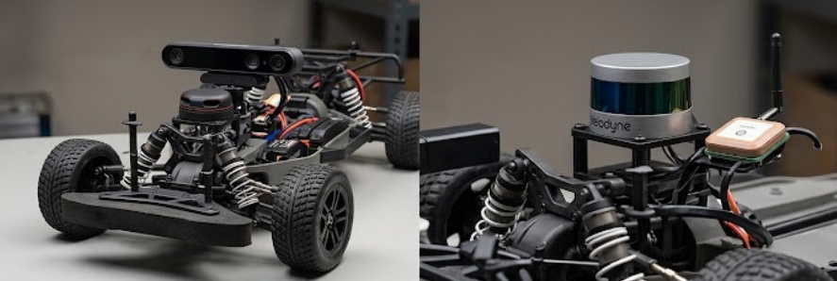
< part-3 · lidar />
The sensor positions are placeholders
The URDF currently puts :
- base_link (=odom) between the rear wheels, on the ground.
- the LiDAR at x = 0.25 m, z = 0.15 m (relative to base_link)
Measure where you mounted your LiDAR, camera and GPS (relative to base_link)
then update robocar_description/urdf/robocar.urdf.xacro
Wrong position = Wrong map
A wrong position gives a wrong map.
Notes:
Measure from base_link: centre of the rear axle, on the ground. Rebuild the control image after editing the xacro, or the old values stay.

Slide 26
< part-3 · lidar />
See it in RViz
On your PC: ROS 2 Jazzy native (Ubuntu 24.04), same ROS_DOMAIN_ID as the car, then run rviz2.
1
Global Options → Fixed Frame: base_link. The default map does not exist yet, hence the red error.
2
Add → TF. You see the base_link, laser, camera_link axes (red = x, green = y, blue = z).
3
Add → LaserScan, topic /scan, size 0.03.
Sanity check
Object in front → on the red axis (x+). Object on the left → on the green axis (y+).
If you see the LiDAR points, you win!
PC sees no topic? README.md §6 (Troubleshooting)
Notes:
If points appear mirrored or rotated, the laser frame orientation in the URDF is wrong. Check left/right with a hand before trusting the scan.

Slide 27
< Part 4 />
SLAM: leads
Build a map while locating the car in it: each new scan is matched against the previous ones to estimate motion, and the map grows as you drive.
This part is yours: leads, not a validated solution.
Guide and known pitfalls: pc/slam/README.md
Notes:
SLAM = Simultaneous Localization And Mapping. Be explicit with students: nothing here is validated on the car yet.

Slide 28
< part-4 · slam />
Where to run it: to be tested
Nobody knows yet whether the Jetson can handle it. Try, measure, decide.
On the Jetson
On your PC
+ pros
+ pros
No network in the loop.
Plenty of CPU, easy to debug with RViz.
− what may block
− what may block
4 small CPU cores, 4 GB RAM shared with the GPU: the map may lag (check with tegrastats).
slam_toolbox is not in the car image: add it.
/scan and TF go over Wi-Fi: a drop or lag loses scans.
PC and Jetson clocks must match, or the data is rejected.
Notes:
Ask groups to report numbers: CPU load and map update rate on the Jetson vs dropped scans over Wi-Fi.

Slide 29
< part-4 · slam · starting-point />
slam_toolbox: install and launch (TO DO)
1
Install it on your PC.
sudo apt install ros-jazzy-slam-toolbox ros-jazzy-nav2-map-server
2
Check its inputs: /scan (~10 Hz), /odom, and ros2 run tf2_ros tf2_echo odom laser must print a transform.
3
Start it with the provided config (the F1TENTH one, adapted).
cd Robocar_ROS2 # your clone of the repository
ros2 launch slam_toolbox online_async_launch.py \
slam_params_file:=$PWD/pc/slam/f1tenth_online_async.yaml use_sim_time:=false
slam_toolbox (github.com/SteveMacenski/slam_toolbox): the standard ROS 2 SLAM library, also used by F1TENTH.
Notes:
On the Jetson this only works if slam_toolbox was added to an image. If tf2_echo odom laser fails, SLAM will not start: fix TF first.

Slide 30

< part-4 · slam · starting-point />
Build and save the map (TO DO)
4
In RViz: Fixed Frame map, then Add → Map, topic /map.
5
Drive slowly with the gamepad (LB). Loops and going back through the same places help.
6
Save the map.
ros2 run nav2_map_server map_saver_cli -f my_room
Tune without the car: record a bag and replay it (pc/slam/README.md).
Notes:
Revisiting places triggers loop closure, which corrects accumulated drift. Recording a bag once lets a whole group tune parameters offline.

Slide 31

< Contacts />
Stuck? Find us on Teams
Jason CHEMIN
Colin CLEARY
Antoine ESMAN
Docs: ARCHITECTURE.md · README.md §6 (Troubleshooting)
Notes:
Leave this slide up during the practical part.

